Slide 1


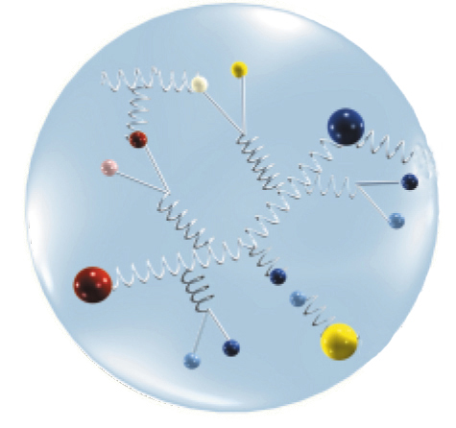

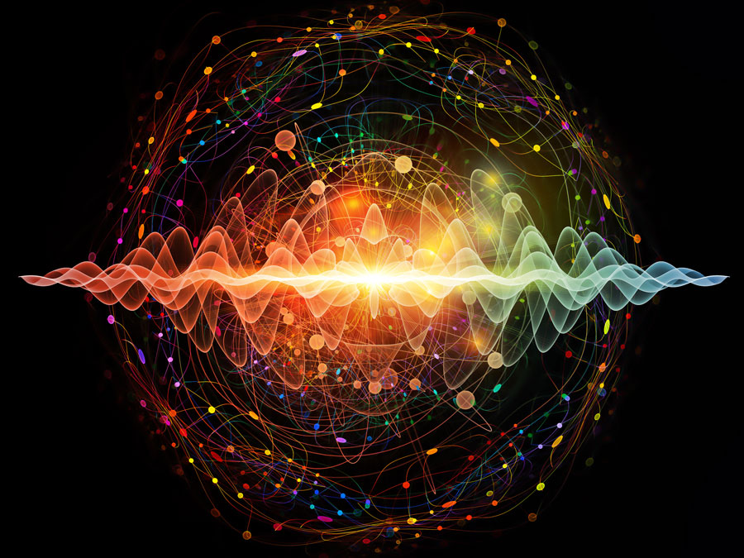
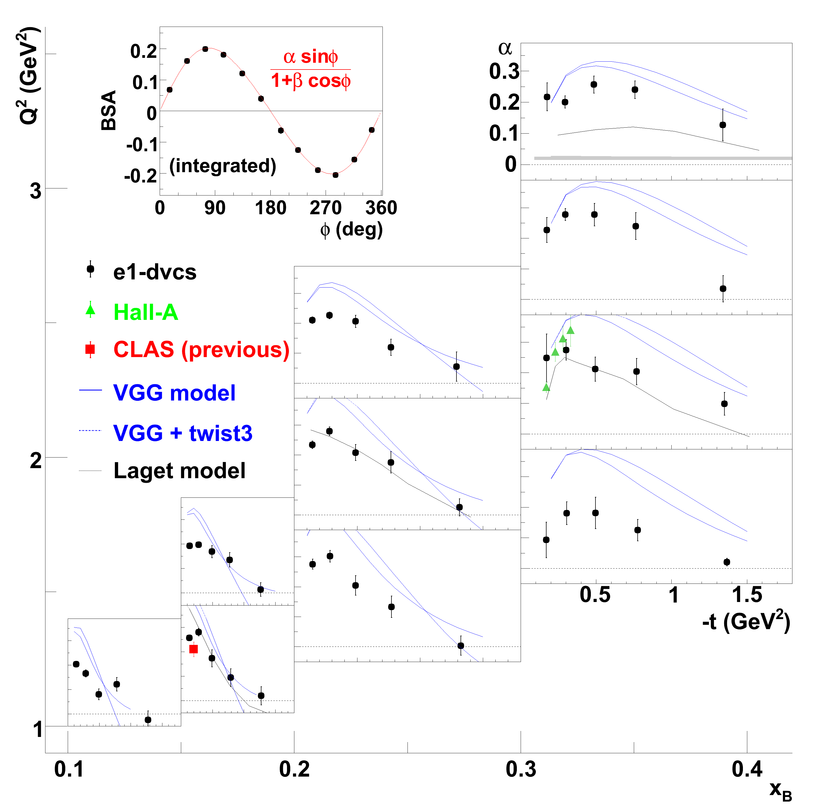
Hall-B Targets
Thomas Jefferson National Accelerator Facility
E1 and that pion cloud
The production of nucleon resonances has been one of the first experiments with the CLAS detector, tagged “E1” for Electro-production: we make resonances by using a beam of electrons.
The first theoretical models of the nucleon describe it as made of quarks bound together by a nuclear potential, and not interacting with each other.
In reality quarks do interact: they exchange gluons. The study of these interactions was the first mission of the CLAS detector, started in 1995.
This is one of the key results obtained in the early 2000’s:
Nucleons are surrounded by a ”cloud” of mesons, that change the properties of the nucleons themselves.
The data heavily favors the models that add the meson cloud to the “bare” quark model of the nucleon.
the “bare” quark model (QM)
of the nucleon.
Top: artistic rendition of the quarks/gluons interactions within the nucleons. Quarks interacts by exchanging “gluons”, the carriers of the strong nuclear force. These interactions happen all the time and sometimes they can produce a quark-antiquark pair for a very brief period of time.
Bottom: how we produced resonances at Jefferson Lab in the first Hall-B experiment: we smashed a very intense, very energetic electron beam against an hydrogen target. For all intents and purposes, as seen by the energetic electrons, the hydrogen atom is just made of protons.
How a meson cloud is formed: gluons can form a meson and and anti-meson pairs from interactions of the quarks within the nucleon.
DVCS and 3D tomography of the proton
Our microscopes to peek inside the nucleons have improved significantly throughout the years.
In the ’60s we thought of the proton as a “fuzzy tennis ball”: we could describe its properties as a whole but we couldn’t see what was happening inside.
Then we discovered particles were made of quarks, and started to understand their role in the nuclear structure. Until very recently however, we were limited to a two-dimensional picture of the nucleons.
With Hall-B and CLAS12 we can now peek deep inside the hadrons and make a 3D tomography of the “guts” of the nucleons by looking at Generalized Parton Distributions, or GPDs.
Our understanding of spin has evolved throughout the years. In the ‘80s we thought the quark spins were solely responsible of the proton total spin. Then we discovered that the quark movement inside the proton contributed as well, but it turns out this contribution was not enough to explain what we observed. Physicists around the world experienced a “spin crisis”!
Today we believe that the gluons also contribute to the total spin of the proton. We’re going to find out more in Hall-B.
CLAS measurements of beam spin asymmetries allowed us to have a peek deep inside the proton. Hall-B will keep investigating.

